Slide 1
Impact Zone: Steps in Identifying Most Vulnerable Populations for COVID-19 Infection
By: Jake JJ Rickord

Slide 2
Understanding our Dataset
We leveraged the database found in Kaggle to access collected information for all 50 states regarding 25 unique metrics such as number of vaccinated individuals, number of hospitals, average health spending per year, pollution, airports, temperature, etc
With this dataset, we identified that our dependent variable (to be measured) was the percentage of population that was infected. From this, we aimed to identify which risk factors (independent variables/features) were the most influential in determining and predicting states that had high infected percentages.
Leveraging this answer, we’d hope to be able to apply this knowledge to identify zones where resources may be needed more heavily due to increased chance of infection.

Slide 3
3/19/2020
This is the format of our “School Closure Date variable”, clearly listed as a date, however to compare with our other variables, which were all numeric, we needed to translate this to a numeric measurement. To do so, we converted all these dates to days since pandemic announced (3/11/2020) to closure. For example, 3/19/2020 would be 8 days. Additionally we filled in some missing values for this column via open-source intelligence gathering.

Slide 4
Feature Reduction
Up next, we look to identify independent variables that are uncorrelated to infection rate based on several different methods

Slide 5
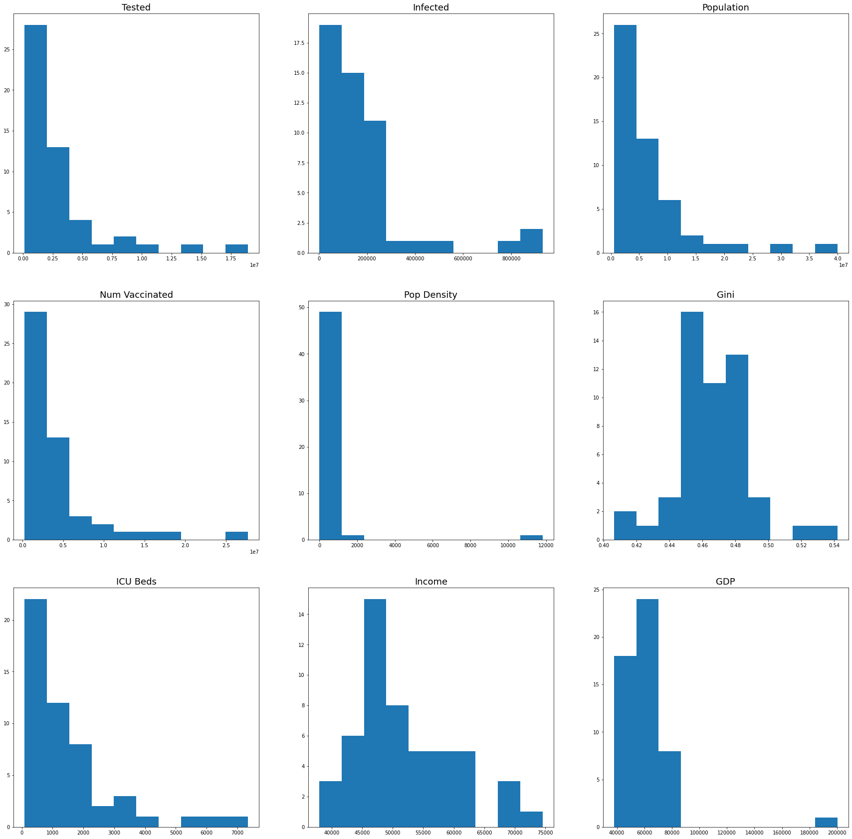
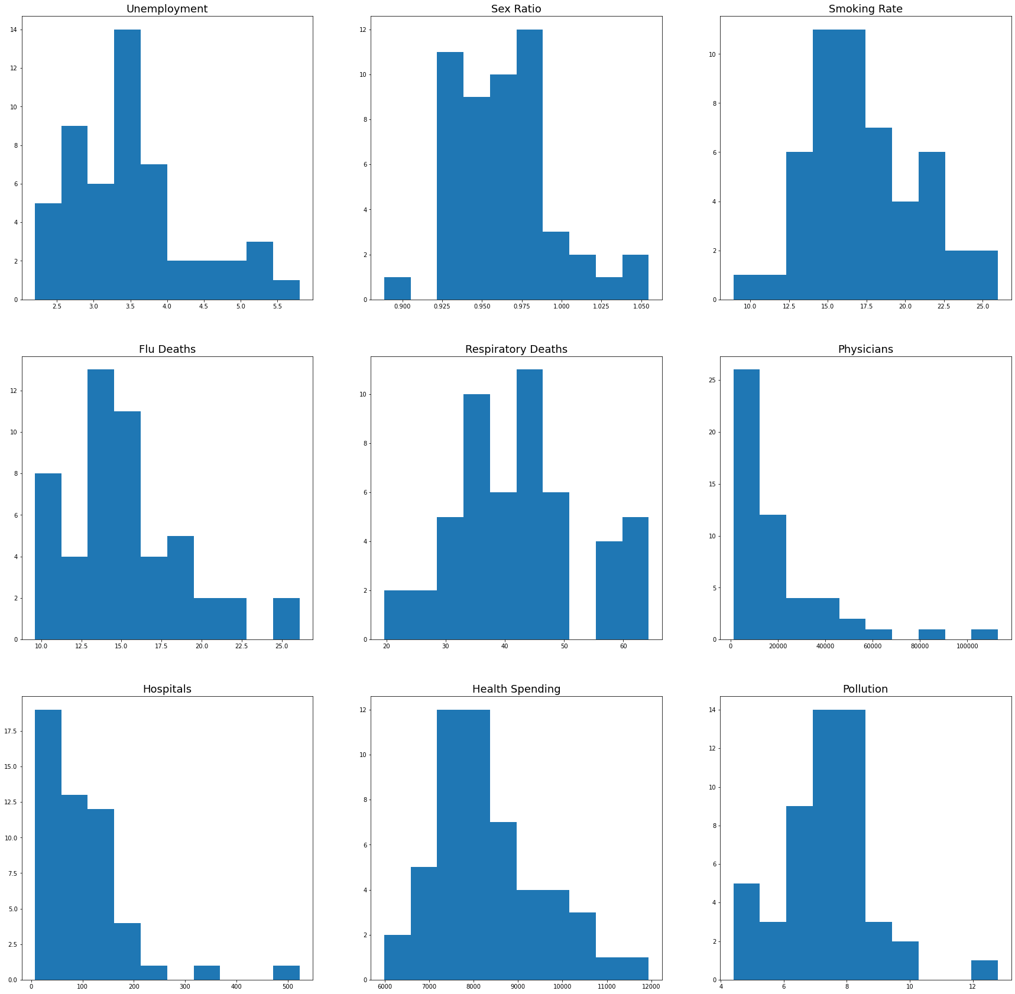
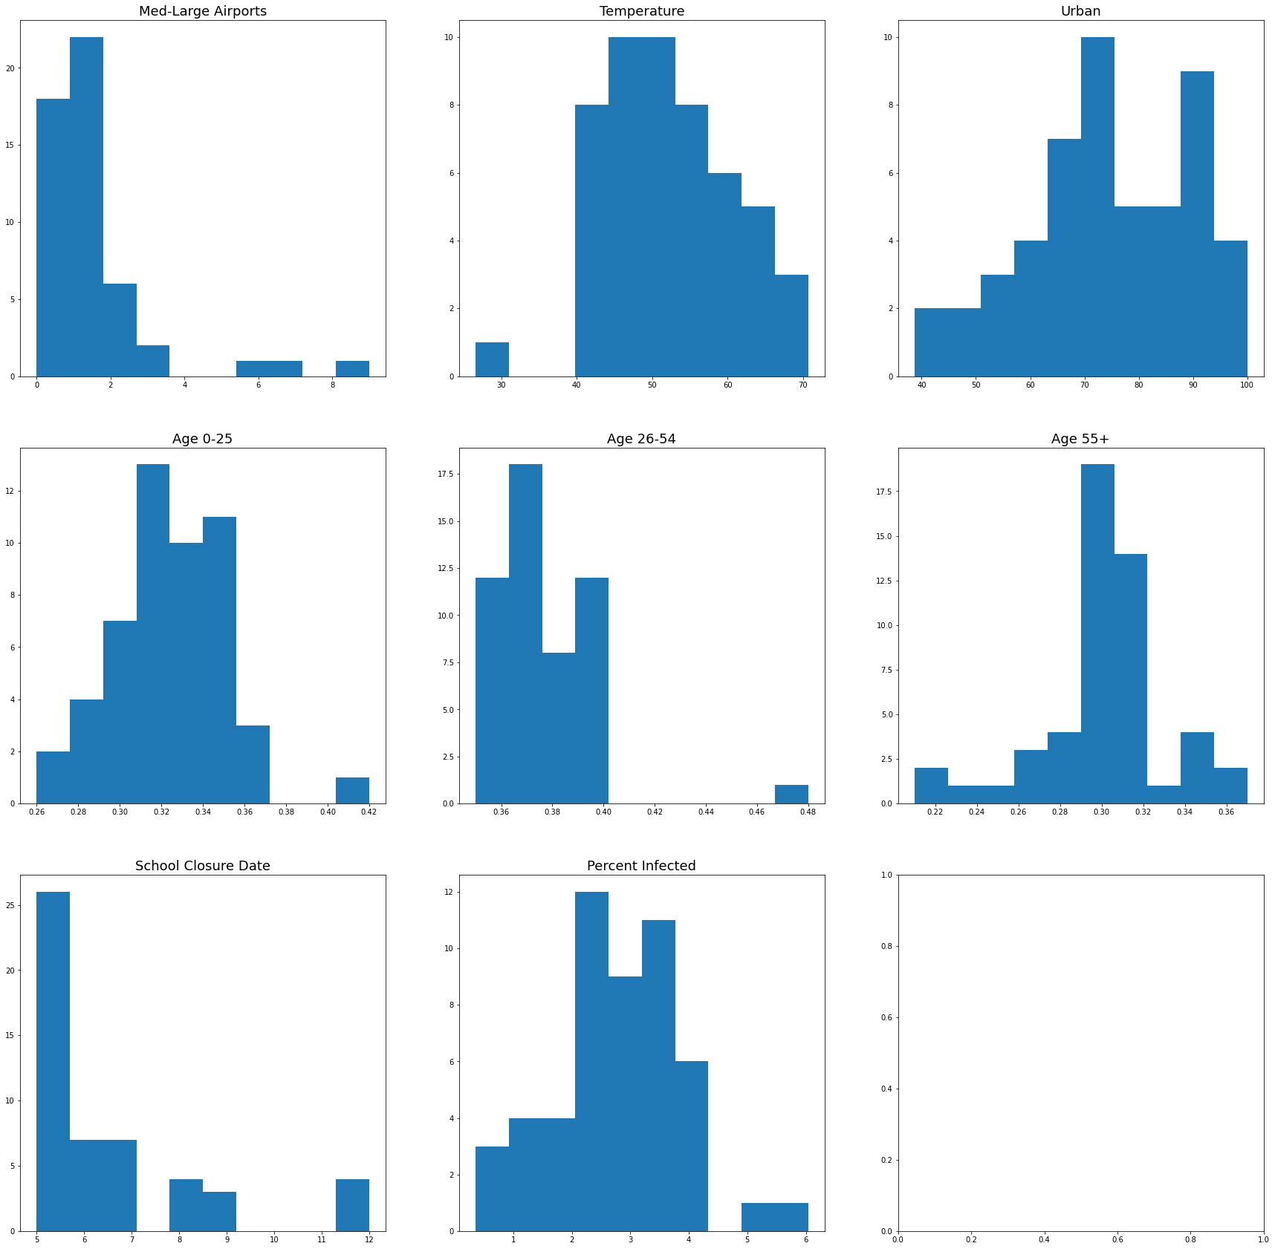
Feature Reduction: Data Visualization
Up first, we examine each variable via histogram plotting to see which line up or are inversions of the infection rate. For those that do not do either, they are likely uncorrelated.

Slide 6
Feature Reduction: Data Visualization (CONT)
From these visualizations, we identified that the only closely followed feature appeared to be Age 0-25 (Percentage of Population 25 or younger). Other variables had little visual direct correlation or inverse correlation with our target variable.

Slide 7
Feature Reduction: Correlation Values
Next, we examine each variable statistically to identify the variance of each variable as it relates to the target of infection rate. Those with variance ratings closer to 0 are least correlated, while those closest to 1 or -1 have the highest correlation or inverse correlation respectively. Our results below once again tell us Age 0-25 is most correlated, Age 55+ is most inversely correlated, and urban rating, population, number of tested individuals, ICU beds, and pollution are the least correlated.
Age 55+ -0.358297
Income -0.292474
Health Spending -0.241999
Age 26-54 -0.190564
GDP -0.113897
Unemployment -0.084418
Physicians -0.082072
Pop Density -0.066183
School Closure Date -0.066106
Num Vaccinated -0.053054
Med-Large Airports -0.050987
Urban -0.024391
Population -0.020490
Tested -0.000316
ICU Beds 0.018565
Pollution 0.027887
Gini 0.065630
Sex Ratio 0.116819
Hospitals 0.123307
Infected 0.154888
Temperature 0.173636
Smoking Rate 0.179333
Respiratory Deaths 0.197148
Flu Deaths 0.231301
Age 0-25 0.616476
Percent Infected 1.000000

Slide 8
Feature Reduction: Univariate Feature Selection
Lastly, we examine each variable again via univariate analysis, this time examining ANOVA f-values for the samples to determine the the best 20 variables to include. From this, the program determined the least correlated features to be Number of Tested Individuals, Number of Vaccinated Individuals, Number of Infected Individuals (outlier here), Population, and School Closure Date

Slide 9
Feature Selection Synopsis
Cross-examining the results of our outputs, we find that two variables were found to be least relevant in conjunction: population, and number of individuals tested. As such, we removed these variables from our dataset.

Slide 10
Modeling

Slide 11
Model 1: Simple Linear Regression
First up: we tried out running a linear regression model on each independent variable to see which had the best chance of predicting the infection rate for states. To do so, we trained our model using only some of the data, and used the leftover data to compare to our predicted values.
There are several measures to identify how “correct’ a model is, so we focused on RSquared and Mean Absolute Error, the results of which can be found on the next slide, however the highest accuracy predictors were number of hospitals, flu deaths, temperature, percent population age 0-25, and income.

Slide 12
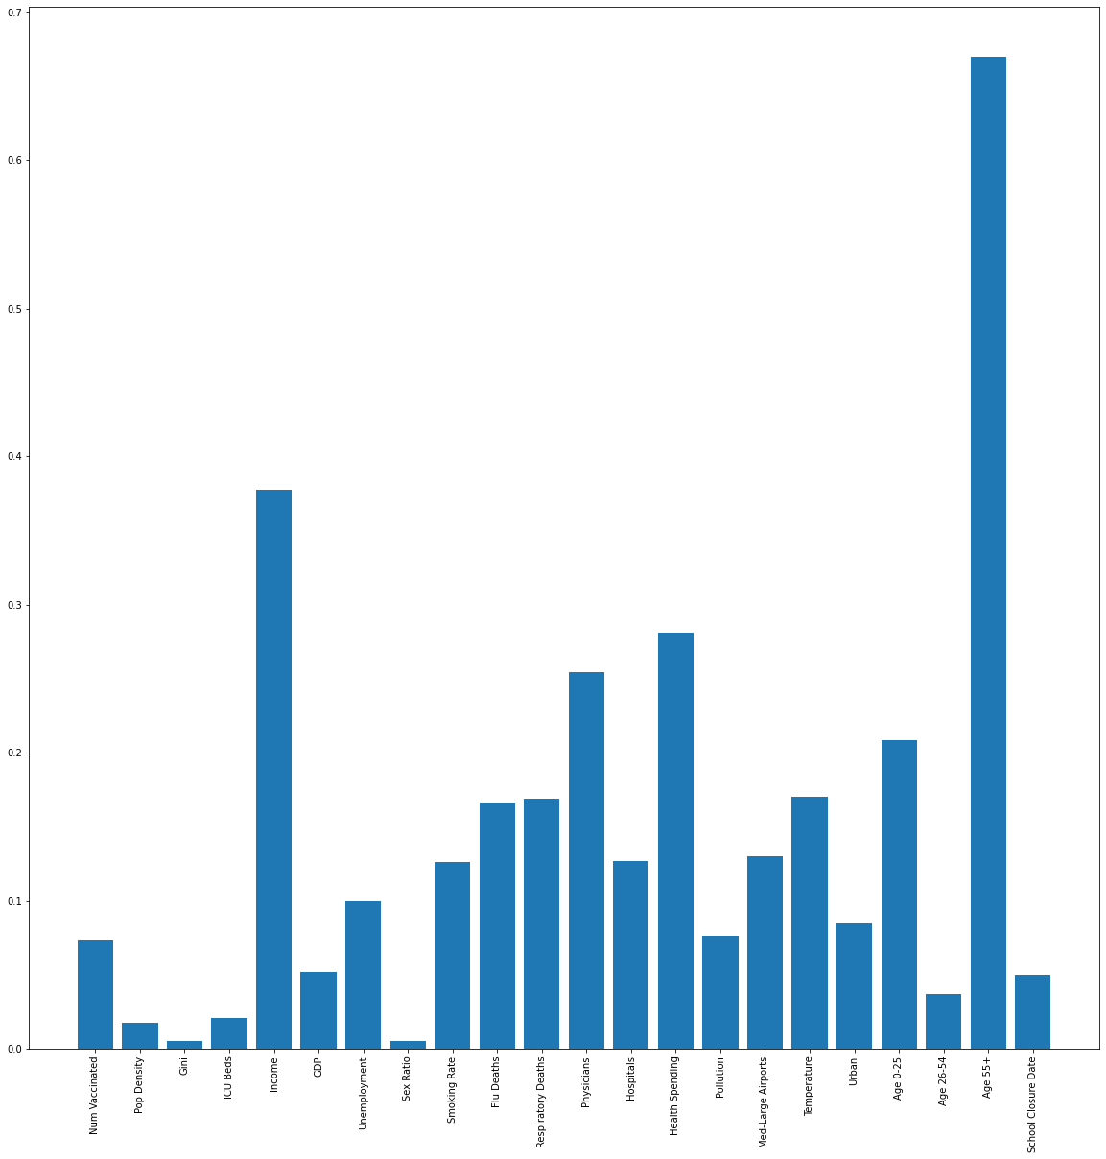
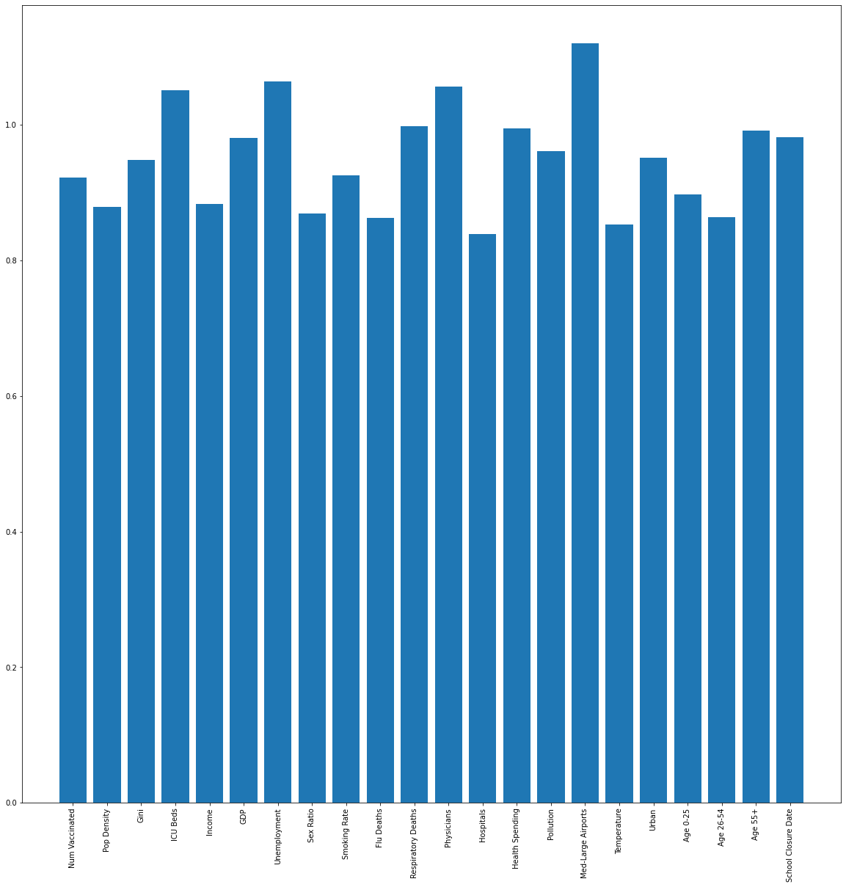

Slide 13
Models 2&3: Lasso & Ridge Modeling
Up next, we examined the dataset using lasso modeling to determine the most important predictors. Lasso modeling works best for situations where variables are highly correlated and possible multicollinearity is a problem
Without knowing exactly how many predictor variables are relevant, we also tested out ridge regression, which generally works better in the case that many are good predictors.
Once again, the coefficient results of each are found on the next page, with lasso regression predicting much better than ridge regression (R squared values being negative here). The most relevant features found via lasso regression were: Gini (wealth disparity), health spending, temperature, and Age (0-25) by a country mile.

Slide 14
Lasso Regression Coefficients
Ridge Regression Coefficients
Num Vaccinated 0.000000
Pop Density 0.000000
Gini 13.021063
ICU Beds 0.000000
Income -0.000000
GDP -0.000000
Unemployment 0.000000
Sex Ratio -0.000000
Smoking Rate 0.000000
Flu Deaths 0.000000
Respiratory Deaths 0.000000
Physicians 0.000000
Hospitals 0.000000
Health Spending -0.000077
Pollution 0.000000
Med-Large Airports 0.000000
Temperature 0.013521
Urban 0.000000
Age 0-25 8.355857
Age 26-54 -0.000000
Age 55+ -0.000000
School Closure Date 0.000000
Num Vaccinated -4.411658e-09
Pop Density 8.425502e-06
Gini 7.342516e+00
ICU Beds 1.662262e-05
Income -9.778047e-06
GDP 5.299924e-08
Unemployment -1.415165e-01
Sex Ratio 2.927704e+00
Smoking Rate 2.078238e-02
Flu Deaths 2.695985e-02
Respiratory Deaths -4.069489e-04
Physicians -1.955883e-06
Hospitals 4.879276e-04
Health Spending 2.255721e-05
Pollution -3.310515e-02
Med-Large Airports -1.771243e-02
Temperature 7.680682e-03
Urban 3.468296e-03
Age 0-25 1.292158e+01
Age 26-54 -7.002878e+00
Age 55+ -5.198805e+00
School Closure Date -6.279785e-02

Slide 15
Next Steps
Coming up next, we will attempt to formalize our findings here. Modeling steps seem to indicate that the highest predictors seems to be young populations, temperature, and also elements tied to economics (health spending and income for simple linear, gini for lasso).
Combine results into formal write-up
Let me know if any other work needs to be done here!

